Slide 1
My Summer Internship at Markel Abhinay Dommalapati – Information Management
markelcorp.com

Slide 2
Agenda
Affirmative/Non-Affirmative Cyber
Cyber survey results/analysis
Cyber 360 and Markel’s stance on “silent cyber”
Binding E&S Homeowners Analysis
Problems with the data
Applying Microsoft Azure’s text analytics service
Performing with known Python tools/packages
Decision tree classifier and recommender system
Underwriter Workbook One Time Analysis
Summary stats/metrics
Understanding the impact of the underwriter workbook
Concluding Thoughts
What I learned

Slide 3
Affirmative and Non-Affirmative Cyber
The problem with non-affirmative or “silent” cyber
Cover the risk of cyber without specific wording
Can’t assess potential risk to loss and can’t identify whether or not Cyber is built into the policy
Data capture standard put together by Tom DiMantova and Jill Goldfine
Importance of capturing data in systems –
Identify policies that cover cyber risk
Attach claim to proper cyber coverage
Manage Markel’s exposure to cyber risk, and appetite
Manage volatility from a cyber event

Slide 4
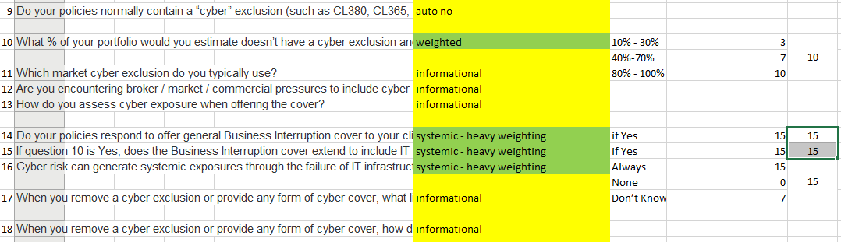
Cyber Survey Scoring
Followed quantitative questions’ scoring and weighting methodologies given by Kara Owens and Ashley Dillon
Found total scores for each survey response and bucketed by risk (Green – Low Risk, Yellow – Medium Risk, Red – High Risk)

Slide 5
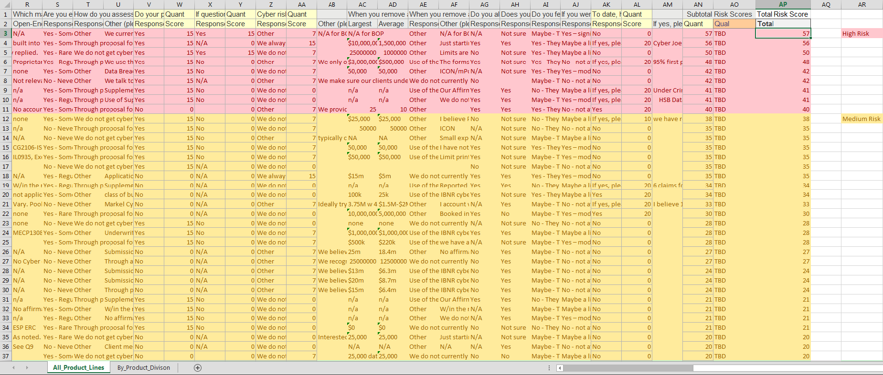
Cyber Survey Results

Slide 6
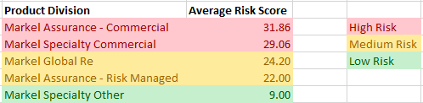
Cyber Survey Analysis

Slide 7

Companies under Cyber 360

Slide 8
Binding E&S Homeowners
Personal lines dataset of policies that qualify for risk outside standard guidelines and sent as referrals to Markel underwriting
Find appetite guidance that can be provided to producers
Pockets of risk that always cause approval/decline
Data challenges
All vital information is in two free text field columns (Risk Details and Reason for Decision)
Approval/Decline classification is imbalanced (Approvals ~ 85%, Declines ~ 15%)

Slide 9
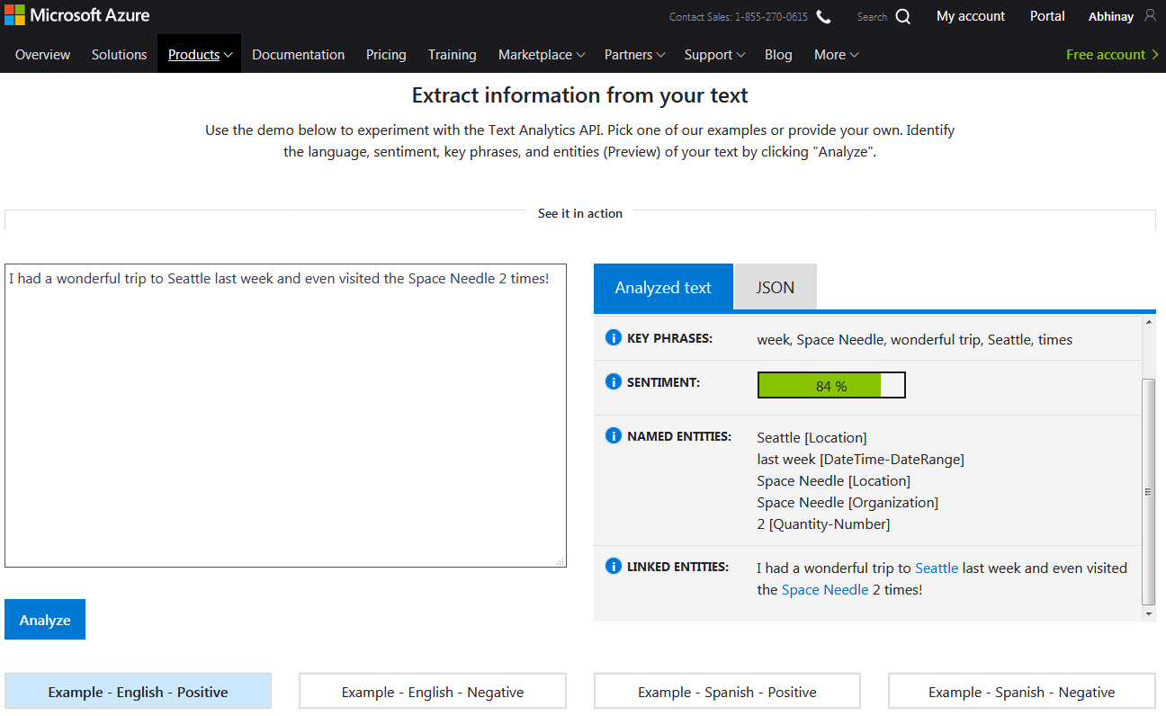
Azure’s Text Analytics Service
Not best equipped to handle insurance text
Could be a powerful tool for product feedback

Slide 10
Python Text Analysis and Risk Classification
Tools
Wordclouds
Bigrams
Regular Expressions
Packages
wordcloud
sklearn.feature_extraction.text
re

Slide 11
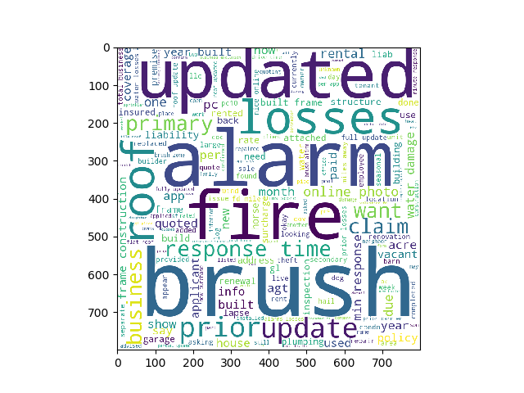
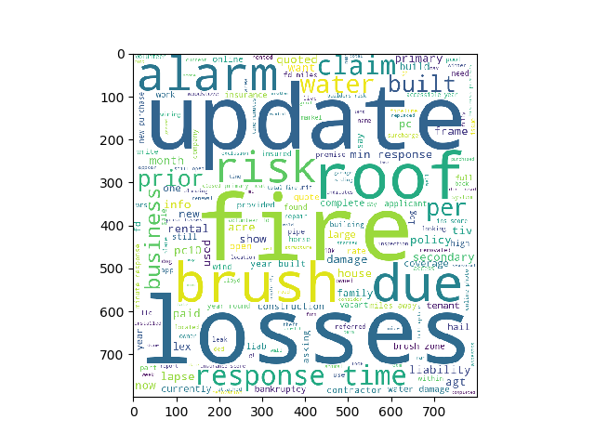
Risk Details WordCloud
Approvals
Declines

Slide 12
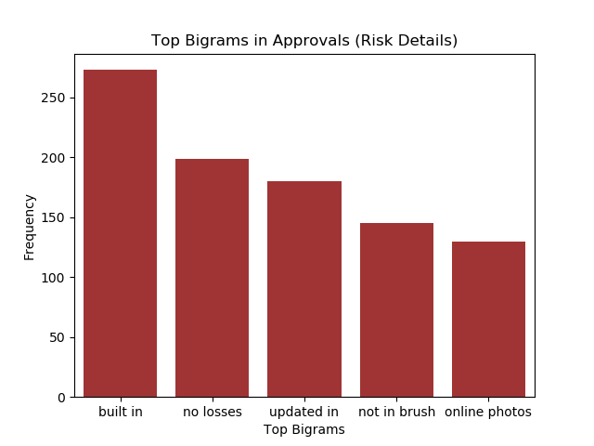
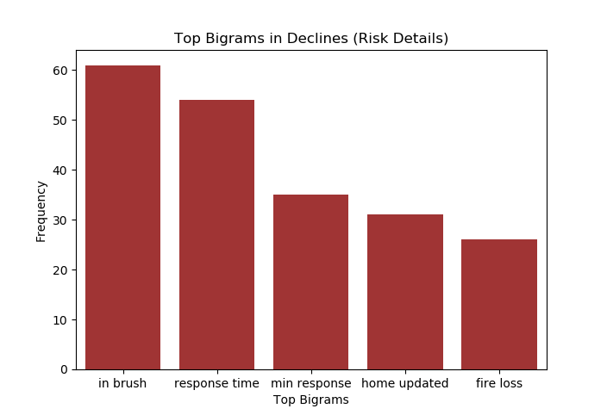
Bigram Analysis

Slide 13
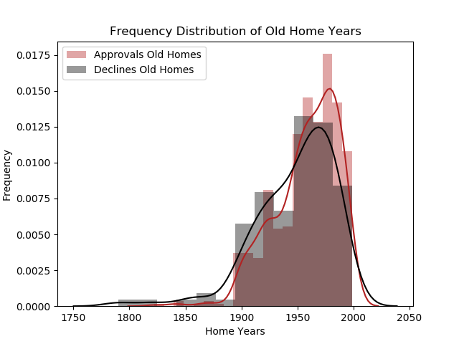
“1940 home updated in 2012”

Slide 14
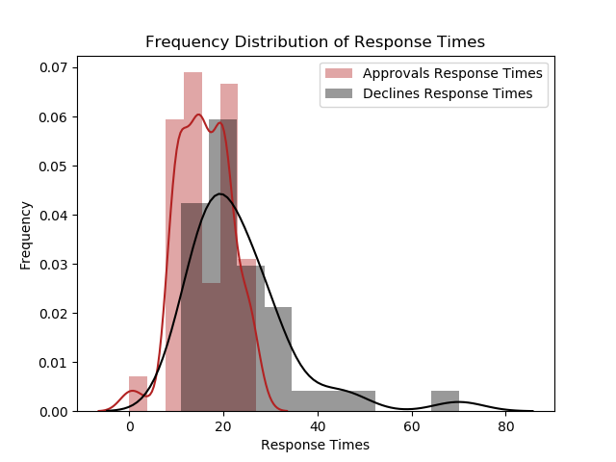
“response time > 15-20 min”

Slide 15
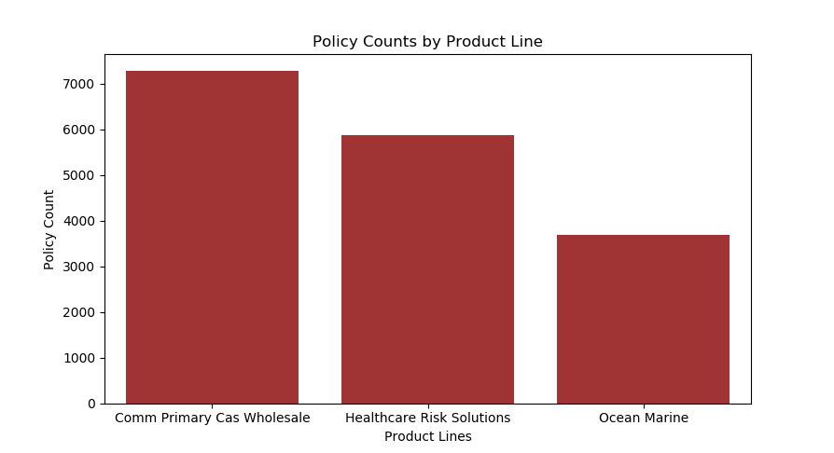
Underwriter Workbook Analysis
Pull information from Renewal_Optimization.XRO_Policies to perform a one time workbook analysis
Gauge the impact of the workbook on business value

Slide 16
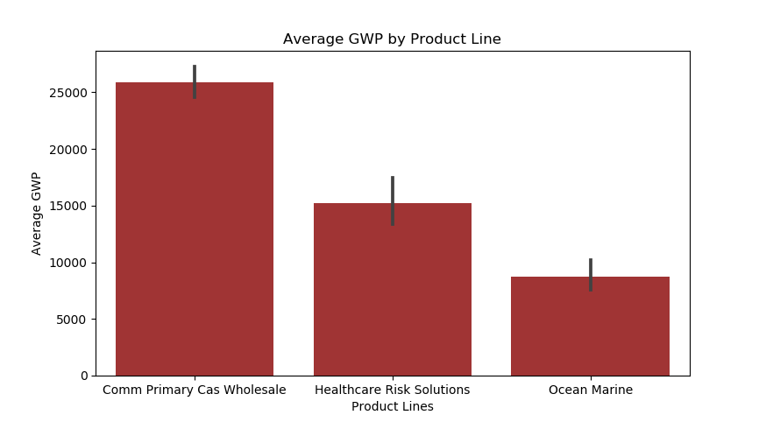
Average GWP by Product Line

Slide 17
Underwriter Efficiency
“Best thing Markel has done for my work since starting here”
“Definitely saves us a lot of time”
Commercial Primary Casualty Wholesale
“10-20 min” before
“5 min” after
Healthcare Risk Solutions
“15-60 min” before
“<5 min” after
Ocean Marine
“20 min” before
“3-4 min” after

Slide 18
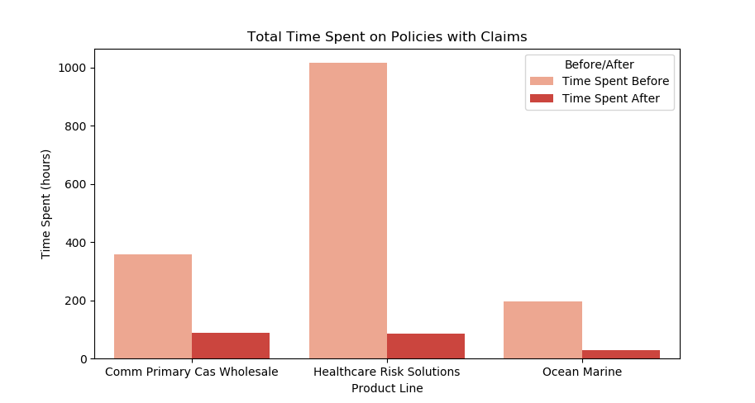
Time Savings Analysis on Policies with Claims

Slide 19
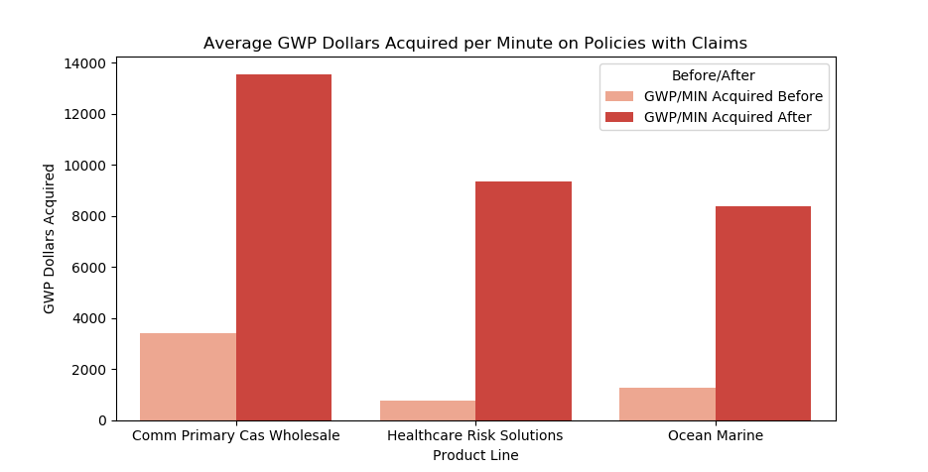
GWP Acquired Analysis on Policies with Claims

Slide 20
What I Learned
How important domain knowledge is to a data scientist
What is real data science
The difficulties of working with real world data
Working on an agile team
Soft skills
Corporate culture
Python, SQL, Microsoft Azure

